Slide 1
Data Structures & Algorithms
Raghu.H.V, Principal Technical Officer, C-DAC, Bengaluru.

Slide 2
Data Structures and Algorithms – Course contents
Introduction to Algorithms.
Introduction to Data Structures.
Stacks and Queues.
Linked Lists.
Searching and Sorting Algorithms
Trees
Graphs

Slide 3
Algorithm - Definition
An Algorithm is a Step by Step process to solve a problem, where each step indicates an intermediate task.
Algorithm contains finite number of steps that leads to the solution of the problem.

Slide 4
Algorithm – Properties/Characteristics
Input/Output.
Finiteness.
Definiteness
Effectiveness
Generality

Slide 5
Categories of an Algorithm
Sequence.
Selection.
Iteration.

Slide 6
Sequence: Example
Example:
// adding two numbers
Step 1: start
Step 2: read a,b
Step 3: Sum=a+b
Step 4: write Sum
Step 5: stop

Slide 7
Selection: Example
Selection type of statement is as shown below:
if(condition)
Statement-1;
else
Statement-2;

Slide 8
Iteration: Example
/* Sums a series of numbers */
#include <stdio.h>
int main(void)
{
int n, sum = 0;
printf("This program sums a series of integers.\n");
printf("Enter integers (0 to terminate): ");
scanf("%d", &n);
while (n != 0)
{
sum += n;
scanf("%d", &n);
}
printf("The sum is: %d\n", sum);
return 0;
}

Slide 9
Algorithm to find the largest among three different numbers entered by user
Step 1: Start
Step 2: Declare variables a,b and c.
Step 3: Read variables a,b and c.
Step 4: If a>b
If a>c
Display a is the largest number.
Else
Display c is the largest number.
Else
If b>c
Display b is the largest number.
Else
Display c is the greatest number.
Step 5: Stop

Slide 10
Performance Analysis of an Algorithm
The Efficiency of an Algorithm can be measured by the following metrics.
i. Time Complexity and
ii. Space Complexity.

Slide 11
What is data structure?
A data structure is a particular way of storing and organizing data so that it can be used efficiently.
Data structures are generally based on the ability of a computer to fetch and store data at any place in its memory, specified by a pointer.

Slide 12
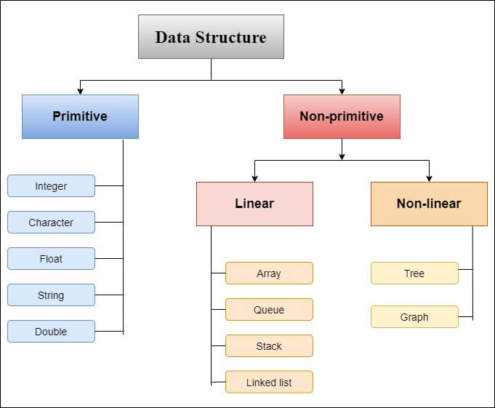

Slide 13
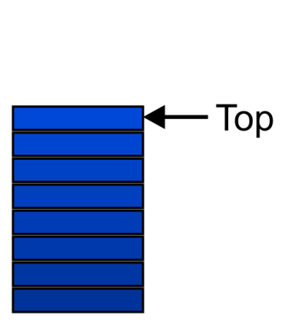
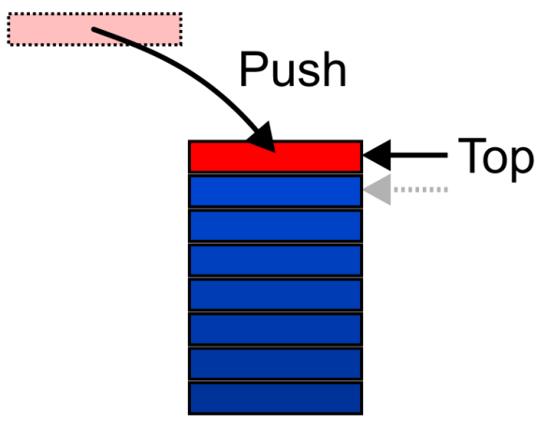
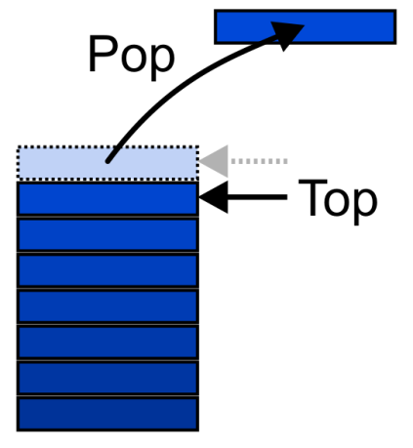


Stack: Introduction
A stack is simply a list of elements with insertions and deletions permitted at one end—called the stack top.
The basic implementation of stack is also called LIFO (Last In First Out)
It is a list like structure, but elements can be inserted or deleted from only one end. It makes stack less flexible than lists.
Many applications need simpler stack rather than lists.

Slide 14
Stack: Introduction
The elements are displayed in reverse order from the insertion of elements into the stack.
Push and pop are the operations that are provided for insertion of an element into the stack and the removal of an element from the stack, respectively.

Slide 15
Operations on Stack
Push
Adds an item onto the stack at the top.
Top
Returns the last item pushed onto the stack.
Pop
Removes the most-recently-pushed item from the stack.
is-empty
True if no more items can be popped and there is no top item.
is-full
True if no more items can be pushed.
get-size
Returns the number of elements on the stack.

Slide 16
Implementation of Stack
Using Arrays
Using Linked Lists

Slide 17
Implementation of Stack using arrays
#define MAX 10
struct stack
{
int arr[MAX] ;
int top ;
} ;

Slide 18
Implementation of Stack using arrays
int main( )
{
struct stack s ;
int i ;
initstack ( &s ) ;
push ( &s, 11 ) ;
push ( &s, 23 ) ;
push ( &s, -8 ) ;
push ( &s, 16 ) ;
push ( &s, 27 ) ;
push ( &s, 14 ) ;
push ( &s, 20 ) ;
push ( &s, 39 ) ;
push ( &s, 2 ) ;
push ( &s, 15 ) ;
i = pop ( &s ) ;
printf ( "\n\nItem popped: %d", i );
i = pop ( &s ) ;
printf ( "\nItem popped: %d", i ) ;
i = pop ( &s ) ;
printf ( "\nItem popped: %d", i ) ;
i = pop ( &s ) ;
printf ( "\nItem popped: %d", i ) ;
i = pop ( &s ) ;
printf ( "\nItem popped: %d", i ) ;
}

Slide 19
Implementation of Stack using arrays
/* intializes the stack */
void initstack ( struct stack *s )
{
s -> top = -1 ;
}
/* adds an element to the stack */
int push (struct stack *s, int data)
{
int data;
if ( s -> top == MAX - 1 )
{
printf ( "\n Stack is full\n" ) ;
return ;
}
s -> top++ ;
s -> arr[s ->top] = data;
}
/* removes an element from the stack */
int pop ( struct stack *s )
{
int data ;
if ( s -> top == -1 )
{
printf ( "\nStack is empty." ) ;
return NULL ;
}
data = s -> arr[s -> top] ;
s -> top-- ;
return data ;
}

Slide 20
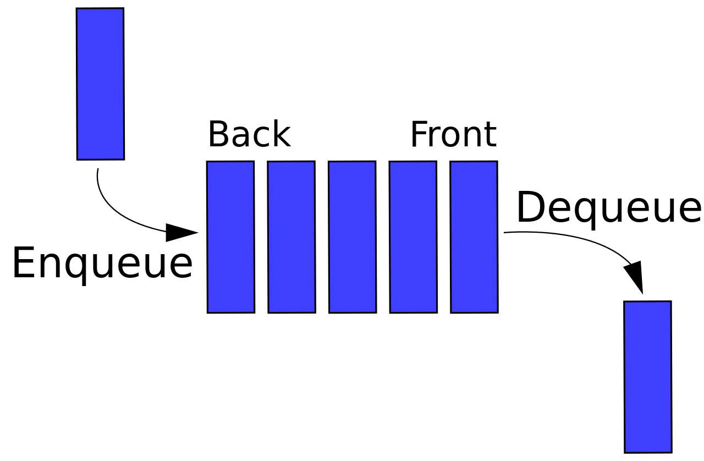
The Queue - Introduction
Definition: A queue is an ordered collection of items where the addition of new items happens at one end, called the “rear,” and the removal of existing items occurs at the other end, commonly called the “front.”
Queues maintain a “First In First Out (FIFO)” ordering property.

Slide 21
Queue
Uses a explicit linear ordering (follows FIFO)
Insertions and removals are performed individually
There are no restrictions on objects inserted into (En-queue) the queue—that object is designated the back of the queue
The object designated as the front of the queue is the object which was in the queue the longest
The remove operation (De-queue from the queue) removes the current front of the queue

Slide 22
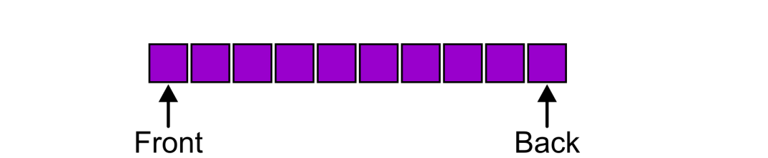
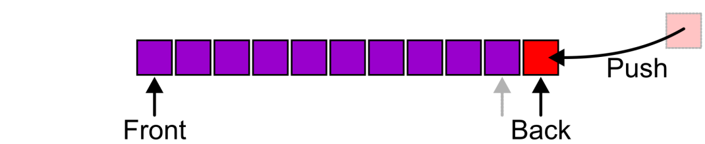
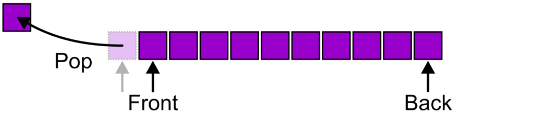
Queue
Enqueue
Dequeue

Slide 23
Queue
There are two exceptions associated with this data structure:
Dequeue on an empty queue.
Enqueue on an full queue.

Slide 24
Implementation of Queue using arrays
#define MAX 50
void main( )
{
int arr[MAX] ;
int front = -1, rear = -1, i ;
addq ( arr, 23, &front, &rear ) ;
addq ( arr, 9, &front, &rear ) ;
addq ( arr, 11, &front, &rear ) ;
addq ( arr, -10, &front, &rear ) ;
addq ( arr, 25, &front, &rear ) ;
addq ( arr, 16, &front, &rear ) ;
addq ( arr, 17, &front, &rear ) ;
addq ( arr, 22, &front, &rear ) ;
addq ( arr, 19, &front, &rear ) ;
addq ( arr, 30, &front, &rear ) ;
addq ( arr, 32, &front, &rear ) ;
i = delq ( arr, &front, &rear ) ;
printf ( "\nItem deleted: %d", i ) ;
i = delq ( arr, &front, &rear ) ;
printf ( "\nItem deleted: %d", i ) ;
i = delq ( arr, &front, &rear ) ;
printf ( "\nItem deleted: %d", i ) ;
}

Slide 25
Implementation of Queue using arrays
/* adds an element to the queue */
void addq ( int *arr, int item, int *pfront, int *prear )
{
if ( *prear == MAX - 1 )
{
printf ( "\nQueue is full." ) ;
return ;
}
( *prear )++ ;
arr[*prear] = item ;
if ( *pfront == -1 )
*pfront = 0 ;
}
/* removes an element from the queue */
int delq ( int *arr, int *pfront, int *prear )
{
int data ;
if ( *pfront == -1 )
{
printf ( "\nQueue is Empty." ) ;
return NULL ;
}
data = arr[*pfront] ;
arr[*pfront] = 0 ;
if ( *pfront == *prear )
*pfront = *prear = -1 ;
else
( *pfront )++ ;
return data ;
}

Slide 26
Queue using Arrays
What is the problem in this code?
Let us fix the array capacity (maxsize) as 5
[ 0 ] [1] [ 2 ] [ 3 ] [ 4 ]
Perform 5 push operations
[ 0 ] [1] [ 2 ] [ 3 ] [ 4 ]
5 | 10 | 15 | 20 | 25
Queue is full
Perform 2 pop operations
[ 0 ] [1] [ 2 ] [ 3 ] [ 4 ]
 |  | 15 | 20 | 25
Queue has 2 free slots??

Slide 27
Queue using Arrays…
What is the problem in this code…?
Perform 2 pop operations
[ 0 ] [1] [ 2 ] [ 3 ] [ 4 ]
Free | Free | 15 | 20 | 25
Queue has 2 free slots
In front of the queue !!
In this case, the array is not full and yet we cannot place any more objects in to the array. Why??
[ 0 ] [1] [ 2 ] [ 3 ] [ 4 ]
 |  | 15 | 20 | 25
Front
Rear

Slide 28
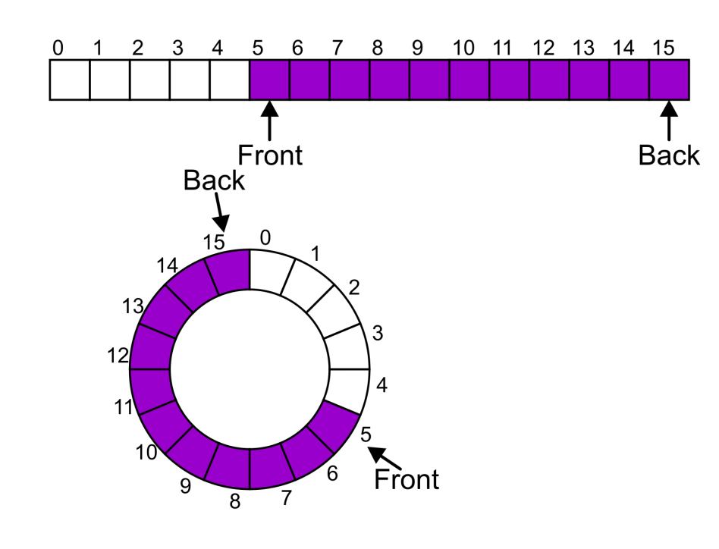
Queue using Arrays…
What is the solution?
Shift array elements after each deletion – Very expensive.
Cyclic arrays - Instead of viewing the array as linear, on the range
“0, 1, 2, 3, 4”, consider the indices by cyclic.
0, 1, 2, 3, 4, 0, 1, 2, 3, 4, 0,……

Slide 29
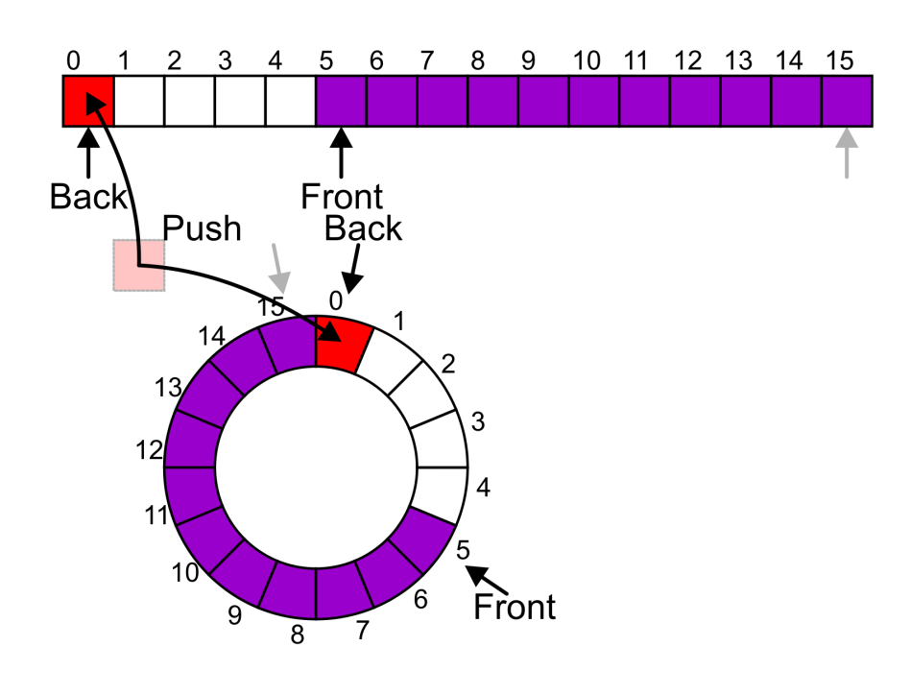
Queue using Circular Array…
What is the solution?
Now the next push can be performed into the next available location of the circular array.

Slide 30
Thank You

